Slide 1


Green SDn: AN approach for power optimization
Gökcan Çantalı

Slide 2
SDN (Software-defined networking)
An emerging paradigm which is based on the decoupling of data plane and control plane
Many data centers have started to
switch to SDN
Easier to program the physical network
A simple overview of SDN architecture [1]

Slide 3

WHY is it important to reduce power ?
More power means more energy consumption:
Global warming
Depletion of natural resources
Electricity bill

Slide 4
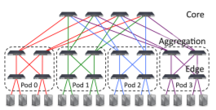
Previous Works
ElasticTree [2]
Formal Model: Mixed-Integer Linear Programming (MILP)
Low-Scalability
Optimum value
Greedy Bin-Packing: Greedy flow assignment
Medium-Scalability
Near-Optimum value
Topology-Aware Heuristic: Splitting flows, only applied to FatTree architecture
High-Scalability
Good value (But not optimum)
Achieves around 40% energy saving compared to the fully powered network.
FatTree Architecture used in [2]

Slide 5
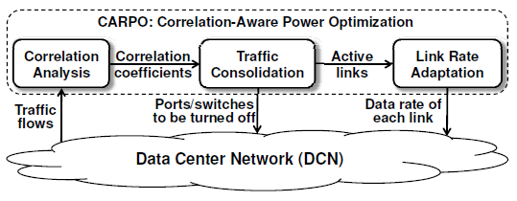
CARPO [3]
First approach = MILP -> Not scalable due to high complexity
Second approach = Correlation-Aware Consolidation Algorithm
Lower complexity, thus higher scalability
Correlation Analysis, Traffic Consolidation, Link Rate Adaptation
Outperforms ElasticTree by 19.6%
The proposed CARPO framework in [3]

Slide 6
Bolla et al. [4]
Specific to SDN environment
Based on pre-computing the paths between nodes and choosing the ones which can satisfy the demand and appear many times in the paths
Energy saving up to 80% compared to the fully functional network
The network topology that is used for the tests in [4]

Slide 7
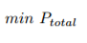
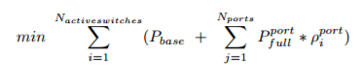
OUR MODEL
Objective Function
Objective Function (In a formal manner)

Slide 8
Given parameters
The number of hosts (N)
The number of ports in a switch (k)
Traffic requirement matrix ([rij])
The bandwidth capacity of each link (Cl)
Pbase and Pport, base power of an active switch and a fully utilized port
Constraints
Link Capacity (fl < Cl for all link l )
Flow Preservation
Decision Variables
Whether or not a switch is active (Edge Switch, Aggregate Switch, Core Switch)
Es = {0,1} for all Edge Switch s
As = {0,1} for all Aggregate Switch s
Cs = {0,1} for all Core Switch s
The flow on each link (fl)

Slide 9

OUR METHOD
An example of a simulated annealing search. [5]
Simulated Annealing is used as the planned solution
Neighborhood structure defines neighbor states between which the number of active switches is only one.
Initial temperature and cooling rate will be decided based on inputs
We will be using FatTree architecture
Python language is used for the implementation
We plan to test our method in Mininet environment with Ryu controller

Slide 10
References
[1] D. Kreutz et al., “Software-defined networking: A comprehensive survey,” Proc. IEEE, vol. 103, no. 1, pp. 14–76, Jan. 2015
[2] B. Heller, S. Seetharaman, P. Mahadevan, Y. Yiakoumis, P. Sharma,S. Banerjee, and N. McKeown, “Elastictree: Saving energy in datacenter networks,” inProceedings of the 7th USENIX Conferenceon Networked Systems Design and Implementation, ser. NSDI’10.Berkeley, CA, USA: USENIX Association, 2010, pp. 17–17. [Online].Available: http://dl.acm.org/citation.cfm?id=1855711.185572
[3] X. Wang, X. Wang, K. Zheng, Y. Yao, and Q. Cao, “Correlation-awaretraffic consolidation for power optimization of data center networks,”IEEE Trans. Parallel Distrib. Syst., vol. 27, no. 4, pp. 992–1006, 2016.[Online]. Available: http://dx.doi.org/10.1109/TPDS.2015.242149
[4] R. Bolla, R. Bruschi, F. Davoli, and C. Lombardo, “Fine-grained energy-efficient consolidation in sdn networks and devices,”Network and ServiceManagement, IEEE Transactions on, vol. 12, no. 2, pp. 132–145, 201
[5] https://upload.wikimedia.org/wikipedia/commons/d/d5/Hill_Climbing_with_Simulated_Annealing.gif

Slide 11
!Thanks for listening!

